Slide 1
WHOOPING COUGH
Dr. Reshma Reghu
Assistant Professor
Dept of Community medicine

Slide 3
Problem statement
Pertussis is an important cause of death in infants worldwide,
During 2012, about 2.49 lac cases were reported to WHO globally & DPT immunization rate was 83 per cent.
It is one of the most lethal diseases of the infants and young children who have not been immunized, particularly those with underlying malnutrition and other respiratory infections.
Pertussis is increasingly reported in older children, adolescents and adults.
A serological study from the United States showed that 21 per cent of adults with prolonged cough (lasting more than 2 weeks) had pertussis.
In India, there is marked decline of the disease after launch of universal immunization programme.
During the year 1987; the reported incidence was about 1.63 lakh cases, whereas during 2013 only 36,661 cases were reported showing a decline of about 77 per cent

Slide 6
INFECTIVE PERIOD
Whooping cough is most infectious during catarrhal stage.
The infective period may be considered to extend from a week after exposure to about 3 weeks after the onset of the paroxysmal stage although communicability diminishes rapidly after the catarrhal stage.
Asymptomatic chronic carriers of B. pertussis are uncommon

Slide 8
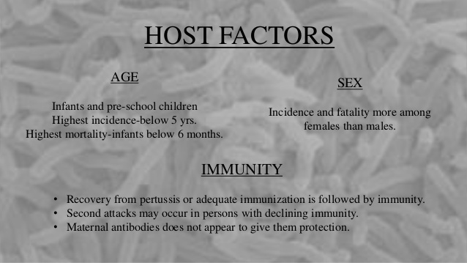

Slide 11
CLINICAL COURSE
B. pertussis produces a local infection; the organism is not invasive.
It multiplies on the surface epithelium of the respiratory tract and causes inflammation and necrosis of the mucosa leading to secondary bacterial invasion.
Three stages are described in the clinical course of the disease:

Slide 13
The incidence of pertussis-associated encephalopathy is 0.9 per cent 100,000.
In industrialized countries, lethality of pertussis is very low ( < 1/1000)
In developing countries the average mortality is estimated at 3.9 per cent in infants and 1 per cent in children aged 1-4 years

